Slide 1
The visionz project
Eportal and app for powerful learning

Slide 2
agenda
The elearning revolution
Elearning apps: reshaping education
Introducing the Visionz ePortal and app
Who needs the ePortal / app?
EPortal / app features
Funding the program
Project founder: Chris Rivers
Project founder: Willie Rivers
In closing
Contact info

Slide 3
Elearning: a revolution in education

Slide 4
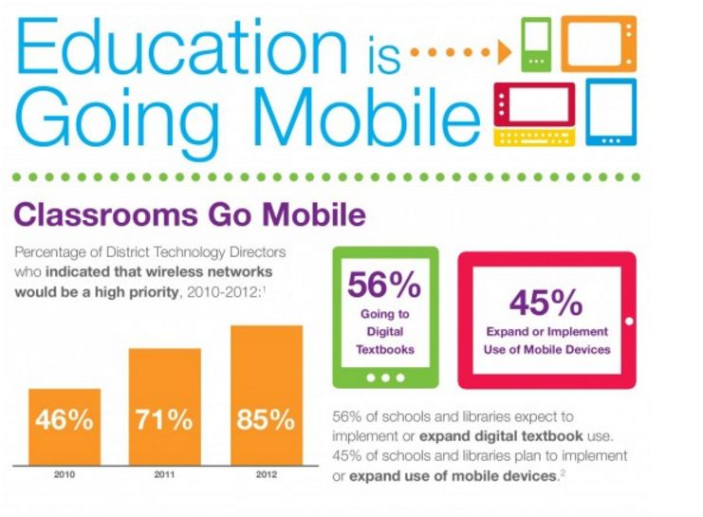
Learning apps: reshaping education

Slide 5
Introducing the visionz eportal and app
The Visionz ePortal and app and were designed to teach at-risk and other youth in the way they learn best – electronically. Using the app and ePortal, students are given a seamless, engaging learning experience that allows them to absorb life-changing lessons in finance, business etiquette, web development, professional success, and more.

Slide 6
Visionz: who needs the eportal / app?
The Visionz ePortal is a web-based, engaging educational tool for
young people who struggle to learn some of the most important life
lessons and skills. If a young person:
Has no idea how to balance a budget or manage finances...
Lacks the social skills or know-how to navigate social situations
(both inside and outside business)...
Wants to enter the workforce, but doesn’t know how...
Needs to learn a professional trade, like web design, but lacks
the resources to get that education...
They need the Visionz ePortal and accompanying app

Slide 7
Eportal / app features:
The elements of the ePortal and app include:
Interactive content
A custom avatar guides users through sections, using role play and
other media to teach lessons
Social media
Users can interact and challenge other users to skills contests
Testing and training
Interactive, multimedia quizzes and tests gauge student knowledge
Self-paced experience
Users learn at their own pace and can return to finished sections.

Slide 8
FUNDING THE PROGRAM: OUR PLAN
By connecting with private investors and crowdfunders, here’s
how we’ll support the program:

Slide 9
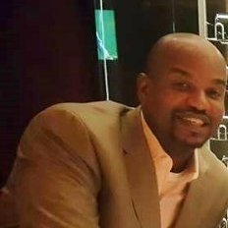
Project founder: Chris rivers
More than 15 years working with established companies, startups and offshore environments
Launched major national sales campaigns for Time-Warner and other companies
Boys and Girls club mentor for more than 15 years
Procured free, refurbished computers for at-risk youth
Taught Detroit teens how to earn money and invest in their futures

Slide 10
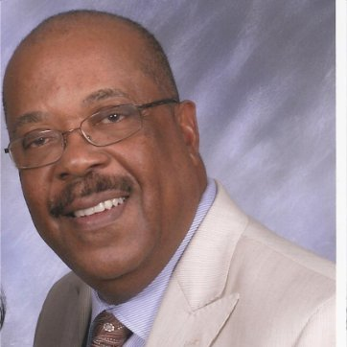
project founder: Willie rivers
30 years in management at Ford Credit Managed a budget of $300 million
Chairman of Ford’s Personnel Development committee
Led 175 management-level employees
Helped almost 400 dealers hire, nurture and train minority talent
Founded the R&R group (a diversity awareness and inclusion-focused consulting firm

Slide 11
In closing
With the Visionz app and ePortal, we help youth prepare for the
workforce, handle their finances, and succeed in social situations,
both personally and professionally.
When a single, errant Facebook post can eliminate a job
opportunity, or the lack of a sound budget can leave a
person homeless, the Visionz app and ePortal become critical
learning components of a young
person’s life.
Help us make a difference.

Slide 12
Contact info
For more information, please contact us at:
800-617-0093
criv@visionz.org
www.visionz.org

